Slide 1






PROJECT
PRESENTATION
Presented by: group 1

Slide 2


INTRODUCTION
our study is about the ability of LLMs to genrate well-written documents, We analyze five papers to determine their relevance to our study, focusing on the accuracy, usefulness, and maintainability of LLM-produced documentation.

Slide 3
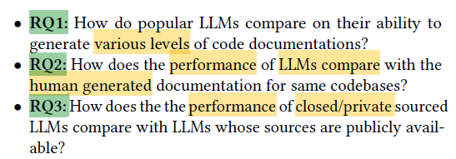
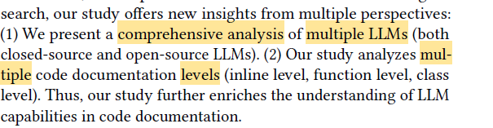
FIRST PAPER:
COMPARATIVE ANALYSIS OF LARGE LANGUAGE MODELS FOR
CODE DOCUMENTATION GENERATION
IDEA:
THE STUDY AIM TO:
WHAT MAKE THIS STUDY SPECIAL?

Slide 4


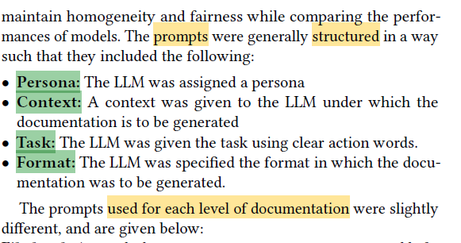
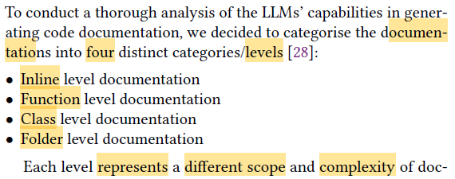
METHODOLOGY
PROMPTS STRUCTURE
DOCUMENTAUION LEVELS

Slide 5
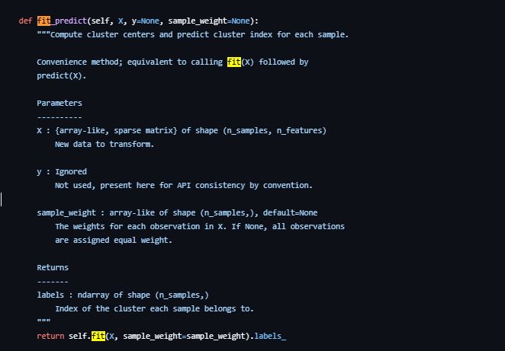
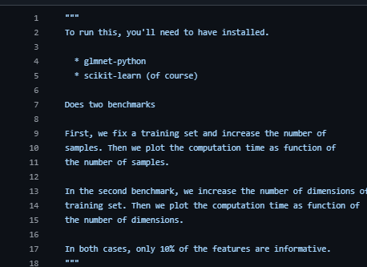
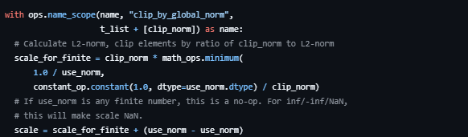
METHODOLOGY
DOCUMENTAUION LEVELS
IN-LINE
FUNCTION LEVEL
FILE LEVEL

Slide 6
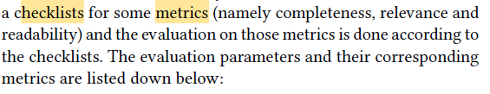

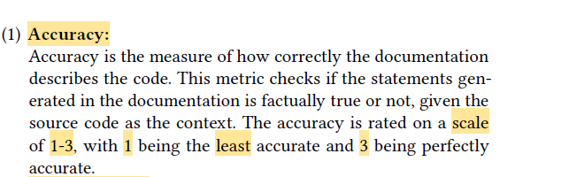
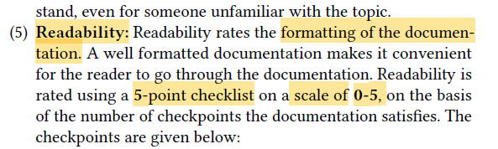
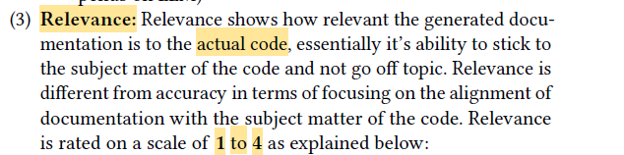
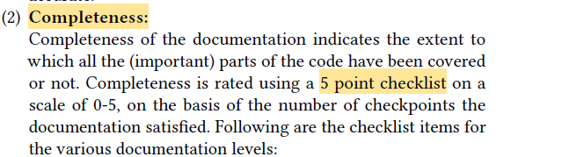
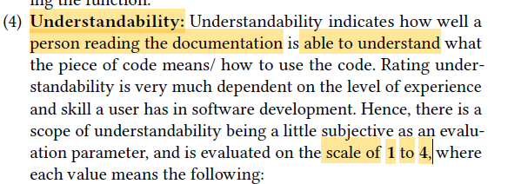

METRICS
SIX ATTRBIUTES

Slide 7

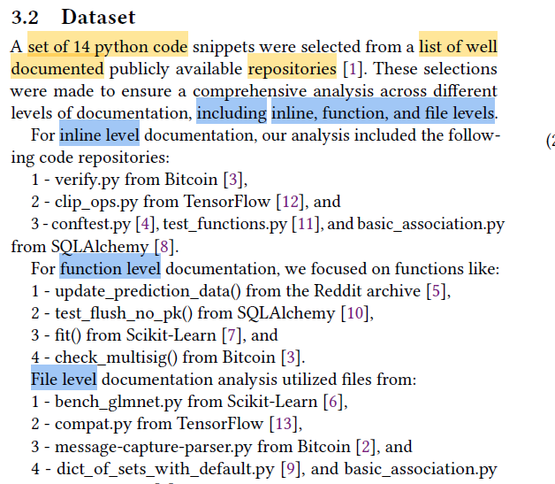


DATA SET
BASED ON WHAT THEY TOOK THE DOUMENTS?

Slide 8
RESAULT AND REFLECTION
RESAULT
REFLECTIONS
THE STUDY DOES NOT SHOW IF THE PROMPTS ARE ZERO-SHOT OR FEW-SHOT.
ALTHOUGH THE SUBJECT IS RELEVENLTY NEW BUT IS HAS A GREATE PRFORMANCE.
THE DATASTS THAT ARE USED ARE PUBLICK ABAILABLE.
USING LLMS HAS POTIONTION TO SPEED UP THE SOFTWARE DEVOPMENT PROCESS.
THEIR RESULT IS THAT ALL THE LARGE PERFORMANCEover the original documentation (HAS MORE POINTS).
additionally file level documentation has lowest performance in all attributesexcept the time taken.

Slide 9
SECOND PAPER
Testing the Effect of Code Documentation on Large
Language Model Code Understanding

Slide 10
IDEA
with the impressive abilities of Large Language Models (LLMs), little work has investigated how documentation and other code properties affect an LLM’s ability to understand and generate code or documentation. this paper presnt how underlying properties of code or documentation can affect an LLM’s capabilities

Slide 11
METHODOLOGY
TASK THE LLM WITH GENERATING UNIT TESTS FOR A PIECE OF SOFTWARE WHILE VARYING THE QUALITY OR QUANTITY OF THE DOCUMENTATION, WE THEN RUN THE UNIT TESTS AND RECORD EACH TEST AS
1 OF 3 RESULTS:
RUNTIME ERROR
FAILURE
SUCCESS
WHERE A UNIT TEST CRASHED BEFORE IT COULD FINISH RUNNING.
WHERE A UNIT TEST RAN AND SUCCESSFULLY PASSED
WHERE A UNIT TEST RAN BUT FAILED TO PASS.

Slide 12
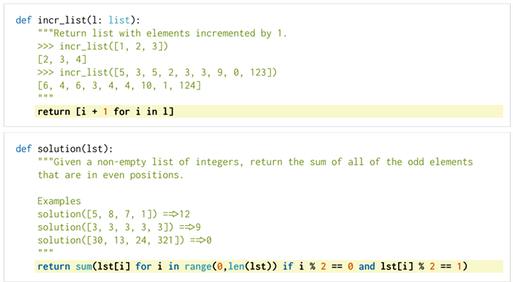
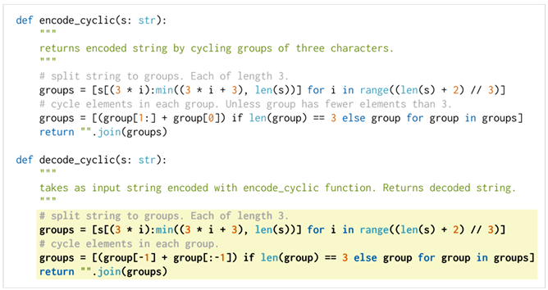
DATASET
THE STUDY USES 164 GROUND-TRUTH SOLUTIONS FROM HUMANEVAL,
A COMMON BENCHMARK FOR EVALUATING LLMS ON CODE UNDERSTANDING

Slide 13
METRICS👌
THE FUNCTIONS ARE MODIFIED IN DIFFERENT WAYS TO TEST HOW DOCUMENTATION AND NAMING CONVENTIONS AFFECT THE LLM’S ABILITY TO GENERATE VALID UNIT TESTS.
THE VARIATIONS INCLUDE:
BASE FILE: ONLY THE FUNCTION DEFINITION WITHOUT ANY DOCUMENTATION.
COMMENTS: THE FUNCTION WITH ITS ORIGINAL DOCSTRING AND COMMENTS.
RANDOM COMMENTS: THE FUNCTION WITH AN UNRELATED DOCSTRING FROM ANOTHER FUNCTION.
ANIMAL VARIABLE NAMES: ALL VARIABLE AND FUNCTION NAMES REPLACED WITH ANIMAL NAMES.
RANDOM VARIABLE NAMES: ALL VARIABLE AND FUNCTION NAMES REPLACED WITH RANDOM STRINGS.
PARTIAL DOCSTRINGS: THE FUNCTION’S DOCSTRING IS RANDOMLY REDUCED TO 10%, 25%, 50%, OR 75% OF ITS ORIGINAL CONTENT.
ANY TEST EXCEEDING 10 SECONDS IS AUTOMATICALLY MARKED AS FAILED TO PREVENT INFINITE LOOPS.

Slide 14
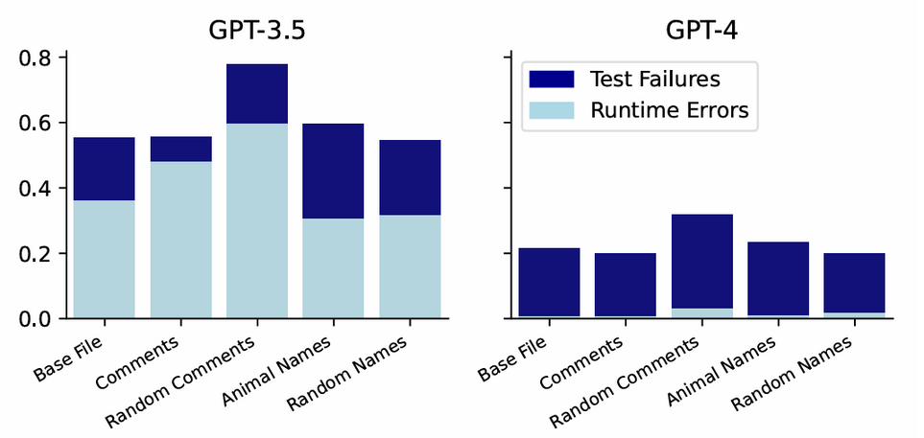
RESULTS
MANY OF THE RUNTIME ERRORS WERE CAUSED BY ASSERT STATEMENTS FAILING (GPT-3.5).
RANDOM COMMENTS SCENARIO PERFORMS WORSE THAN ANY OTHER SCENARIO ON BOTH GPT-3.5 AND 4 ( INCORRECT DOCUMENTATION CAN HURT AN LLM’S UNDERSTANDING).
CHANGING THE VARIABLE NAMES HAD A RELATIVELY MINOR EFFECT ON THE LLM’S CODE UNDERSTANDING.
CHANGING THE VARIABLES TO ANIMALS DID CAUSE A STATISTICALLY SIGNIFI CANT CHANGE.
HAVING COMMENTS DID NOT SIGNIFICANTLY INCREASE THE LLM’S ABILITY TO UNDERSTAND THE CODE.
THE NUMBER OF RUNTIME ERRORS PRODUCED BY GPT-3.5 IS MUCH GREATER THAN THOSE PRODUCED BY GPT-4

Slide 15
REFLECTION
EVEN WHEN COMPARING COMMENTED CODE WITH NON-COMMENTED AND CHANGE VARIABLE NAMES TO RANDOM, WE FIND LITTLE TO NO SIGNIFICANT DIFFERENCE IN THE LLM’S ABILITY TO GENERATE SUCCESSFUL UNIT TESTS
THIS PAPER SHOW THAT THE RELATIVE PREVALENCE OF DOCUMENTATION HAS LITTLE TO NO SIGNIFICANT EFFECT ON AN LLM’S UNDERSTANDING

Slide 16
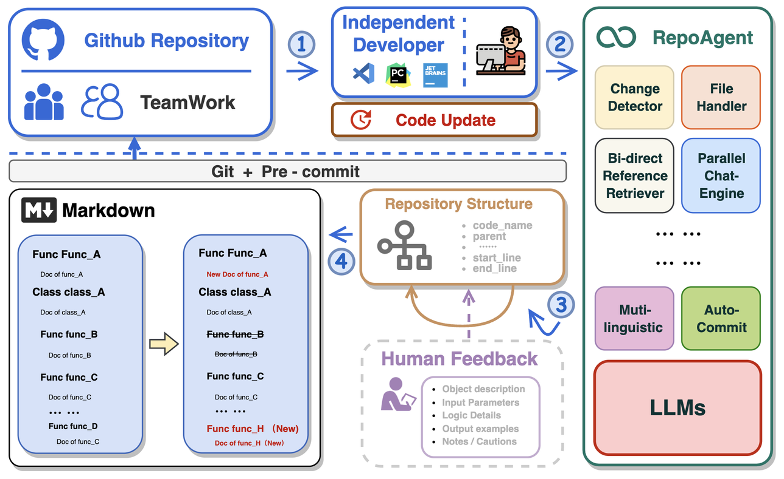
THIRD PAPER: AN LLM-POWERED OPEN-SOURCE FRAMEWORK FOR REPOSITORYLEVEL CODE DOCUMENTATION GENERATION
FADI ALZAHRANI

Slide 17
IDEA
DEVELOPERS TYPICALLY SPEND APPROXIMATELY 58% OF THEIR time on program comprehension
MAINTAINING CODE DOCUMENTATION ALSO TAKES A LOT OF EFFORT, TIME AND MONEY FOR DEVELOPERSS
NOT ALL DOCUMENTATION ON THE INTERNET HAD THE SAME AMOUNT OF INVESTMENT TO CREATE
PREVIOUS ATTEMPTS TO AUTOMATE DOC GENERATION HAD ISSUES: POOR SUMMARIZATION, INADEQUATE GUIDANCE AND PASSIVE UPDATE

Slide 18
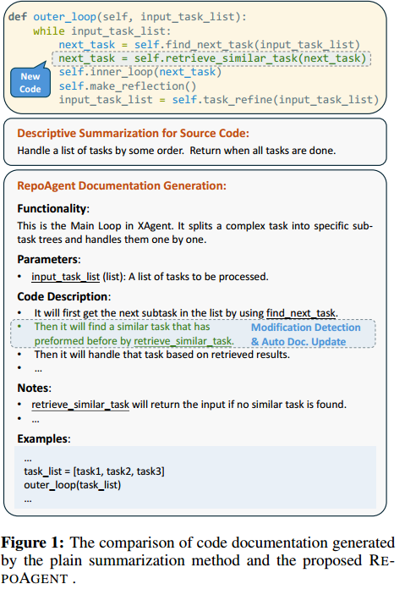
METHOD
TO SOLVE THESE ISSUES, THE PAPER PRESENTED A FRAMEWORK CALLED REOPAGENT POWERED BY LARGE LANGUAGE MODELS TO AUTOMATICALLY GENERATE REPOSITORY-LEVEL CODE DOCUMENTATION

Slide 19
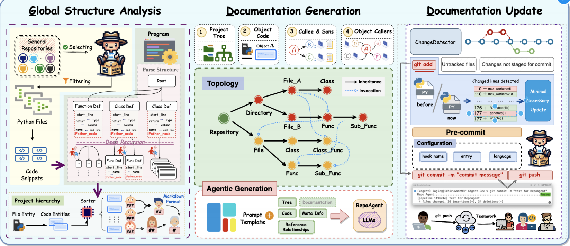

Slide 20
THIS IS THE FIRST STAGE AND IT INVOLVES
PARSING DATA AND GLOBAL CONTEXTUAL RELATIONSHIPS FROM
THE SOURCE CODE
FOUNDATION FOR REPOAGENT TO INFER FUNCTIONAL
SEMANITCS OF THE CODE
A TECHNIQUE USED TO ANALYZE AND INTERPRET THE SYNTAX OF A TEXT OR PROGRAM TO EXTRACT RELEVANT INFORMATION. ESSENTIALLY, PARSING INVOLVES BREAKING DOWN A COMPLEX SET OF DATA STRUCTURES OR CODE INTO SMALLER, MORE MANAGEABLE COMPONENTS THAT CAN BE ANALYZED AND UNDERSTOOD

Slide 21
THE PARSED META INFORMATION AND REFERENCE RELATIONSHIPS ARE TAKEN TO THIS STAGE TO BE SENT TO A BACKEND LLM

Slide 22
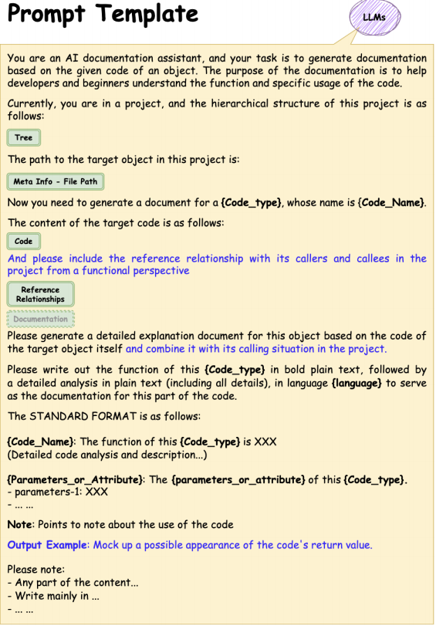
THE PROJECT TREE HELPS REPOAGENT PERCEIVE THE REPOSITORY-LEVEL CONTEXT
THE CODE SNIPPET SERVES AS THE MAIN SOURCE OF INFORMATION FOR REPOAGENT TO GENERATE THE DOCUMENTATION.
THE REFERENCE RELATIONSHIPS PROVIDE SEMANTIC INVOCATION
RELATIONSHIPS BETWEEN CODE OBJECTS AND ASSIST
REPOAGENTIN GENERATING GUIDING NOTES AND EXAMPLES
THE META INFORMATION INDICATES THE NECESSARY INFORMATION SUCH AS TYPE
, NAME, RELATIVE FILE PATH OF THE TARGET OBJECT,
AND IS USED FOR POST-PROCESSING OF THE DOCUMENTATION.

Slide 23
A GIT HOOK IS UTILIZED TO ENABLE REPOAGENT TO DETECT ANY CODE CHANGES AND PERFORM DOCUMENTATION UPDATES.
AFTER THE UPDATE, THE HOOK SUBMITS BOTH THE CODE AND DOCUMENTATION CHANGES, ENSURING THAT THE CODE AND DOCUMENTATION REMAIN SYNCHRONIZED
FULLY AUTOMATED

Slide 24
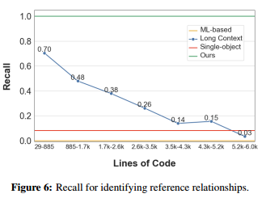
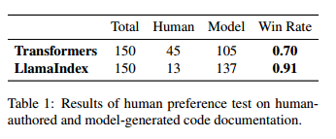
DATASETS AND EVALUATION METRIC
REPOAGENT WAS USED ON NINE PYTHON REPOSITORIES OF VARYING SIZES
TWO WERE USED IN BLIND PREFERENCE TESTS TO COMPARE HUMAN-AUTHORED DOCUMENTATION WITH DOCUMENTATION GENERATED BY REPOAGENT.
THE EVALUATION METRIC USED IS A HUMAN PREFERENCE TESTING – IN TWO BLIND STUDIES

Slide 25
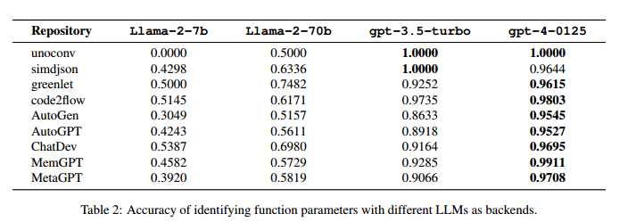
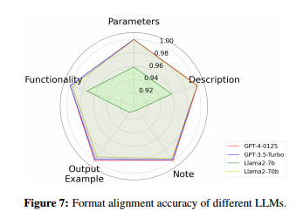
THE RESULTS INDICATE THAT REPOAGENT OUTPERFORMS MODELS THAT RELY SOLELY ON ISOLATED CODE SNIPPETS
THE RESULTS SHOW THAT LLMS LIKE GPT-4 PERFORMED WELL IN MAINTAINING STRUCTURED DOCUMENTATION, WHILE SMALLER MODELS LIKE LLAMA-2-7B EXHIBITED INCONSISTENCIES.
PARAMETER IDENTIFICATION ACCURACY – THE FRAMEWORK WAS TESTED FOR ITS ABILITY TO CORRECTLY EXTRACT AND DESCRIBE FUNCTION PARAMETERS. REPOAGENT, WHEN POWERED BY GPT-4-0125, DEMONSTRATED THE HIGHEST ACCURACY AMONG EVALUATED MODELS.

Slide 26
RESULTS
REPOAGENT WAS SHOWN TO DEMONSTRATE HIGH QUALITY, REPOSITORY LEVEL DOCUMENTATION UNLIKE OTHER TRADITIONAL METHODS
AUTOMATED SYNCHRONIZATION WITH CODE CHANGES BY LEVERAGING GIT HOOKS
NOT ONLY DESCRIBES CODE BUT ALSO PROVIDES EXAMPLES, USAGE NOTES, AND POTENTIAL LIMITATIONS, MAKING IT MORE INFORMATIVE FOR DEVELOPERS.

Slide 27
REFLECTION
PROGRAMMING LANGUAGE LIMITATIONS: ONLY PYTHON
PROJECTS..
REQUIREMENT FOR HUMAN OVERSIGHT: MAY STILL REQUIRE HUMAN REVIEW AND MODIFICATION TO ENSURE ITS ACCURACY AND COMPLETENESS
LACK OF STANDARDS FOR EVALUATION: IT IS DIFFICULT TO
ESTABLISH A UNIFIED QUANTITATIVE EVALUATION. ACADEMIC COMMUNITY LACKS
BENCHMARKS AND DATASETS OF EXEMPLARY HUMAN DOCUMENTATION

Slide 28
FOURTH PAPER:
APIDOCBOOSTER: AN EXTRACT-THEN-ABSTRACT FRAMEWORK LEVERAGING LARGE LANGUAGE MODELS FOR AUGMENTING API DOCUMENTATION
IDEA:
IS A TWO-STEP FRAMEWORK THAT HELP CREATE BETTER SUMMARIES FOR API DOCUMENTATION BY PULLING KEY INFO THEN CREATE CLEAR AND CONCISE SUMMARY

Slide 29
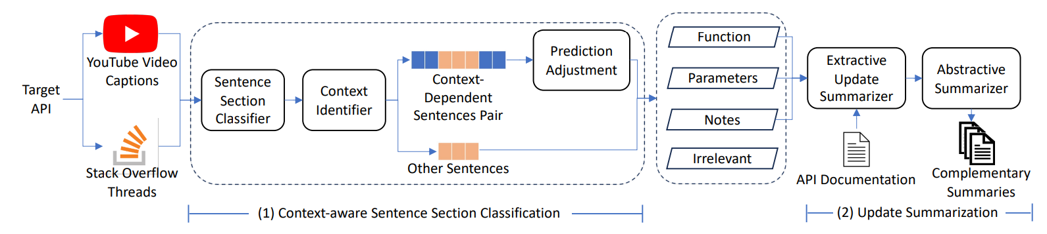
METHODOLOGY
EXTRACTIVE UPDATE SUMMARIZATION ALGORITHM (EXTUP)

Slide 30
METRICS
REDUNDANCY
FAITHFULNESS
UNNECESSARY REPETITION
ACCURACY THE ORIGINAL
INFORMATIVENESS
READABILITY
RELEVANCE
PROVIDED INFORMATION
EASY TO UNDERSTAND
STAYS ON-TOPIC

Slide 31
RESULTS
THEIR DATASET IS ON GITHUB*.
5-POINT LIKERT SCALE
 | Informativeness | Relevance | Readability | Redundancy | Faithfulness
GPT-4 | 3.6 | 3.3 | 4.4 | 4.5 | 3.6
APIDocBooster | 4.1 | 3.8 | 4.5 | 4.5 | 4.7
[1] GITHUB.COM/AUTUMN-CITY/APIDOCBOOSTER/TREE/MASTER

Slide 32
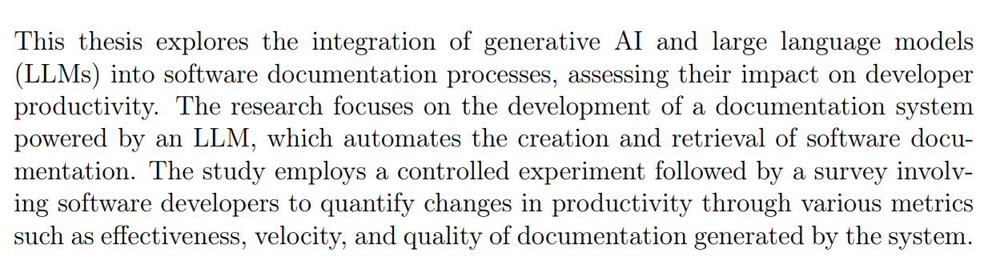
FIFTH PAPER:
LARGE LANGUAGE MODELS FOR DOCUMENTATION: A STUDY ON THE EFFECTS ON DEVELOPER PRODUCTIVITY
IDEA:
THE STUDY AIM TO:

Slide 33
FIFTH PAPER
Large Language Models for Documentation: A Study on the Effects on Developer Productivity

Slide 34
IDEA
The study explores the merging of generative AI and large language models (LLM ) into software-documented processes and evaluates the resulting impact on developer productivity. The purpose is to utilize an LLM-based documentation system to automate the creation and retrieval of software documentation to minimize human manual effort with efficient work practices.

Slide 35
METHODOLOGY
THEIR METHODOLOGY IS A CONTROLLED EXPERIMENT, FOLLOWED BY A SURVEY, TO FURTHER ASSESS THE EFFECTIVENESS OF THE LLM-POWERED DOCUMENTATION SYSTEM. PARTICIPANTS WERE REQUIRED TO GENERATE AND MAKE USE OF DOCUMENTATION USING BOTH MANUAL AND LLM-ASSISTED APPROACHES
CONTROLLED EXPERIMENT
SURVEY
CONDUCTING A CONTROLLED EXPERIMENT ENABLES PRECISE MEASUREMENTS OF PERFORMANCE METRICS SUCH AS TIME, ACCURACY, AND VELOCITY.
A SURVEY CONDUCTED AMONG THE PARTICIPANTS OF THE STUDY INDICATED THAT THE TOOL ENHANCES VARIOUS ASPECTS OF PRODUCTIVITY.

Slide 36
EVALUATION METRIC
THE KEY PRODUCTIVITY METRICS MEASURED AND COMPARED BETWEEN THE TWO APPROACHES WERE
EFFECTIVENESS
VELOCITY
QUALITY
ACCORDING TO HOW LONG IT WOULD TAKE TO CREATE DOCUMENTATION USING EITHER MANUAL OR AI
WHICH LOOKED AT HOW RELEVANT OR ACCURATE THE DOCUMENTATION
RATED FOR UNDERSTANDABILITY, COMPLETENESS, AND READABILITY.

Slide 37
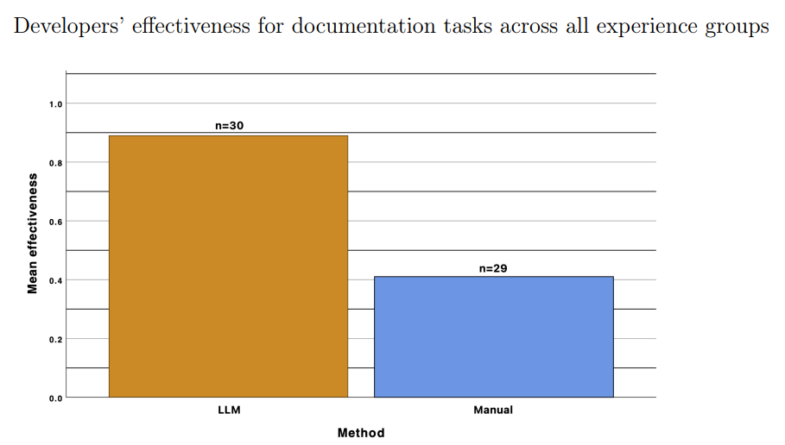
DATASET AND RESULTS
THEIR DATASET IS PRIAVITE BUT IT IS DERIVED FROM A CONTROLLED EXPERIMENT AND SURVEY.

Slide 38
RESAULT AND REFLECTION
RESAULT
REFLECTIONS
ALTHOUGH THE IDEA OF USING LARGE LANGUAGE MODELS (LLMS) IS RELEVANTLY NEW, BUT IT HAS A GOOD IMPACT TO ENHANCE THE DEVELOPER PRODUCTIVITY IN TERMS OF EFFECTIVENESS, VELOCITY AND QUALITY.
THE RESULTS SHOW THAT THE DOCUMENTATION SYSTEM THAT USES LLM IS A GREAT PRODUCTIVITY ENHANCER. IT HELPS DEVELOPERS CREATE AND UNDERSTAND DOCUMENTATION MORE QUICKLY AND ACCURATELY THAN DOING IT MANUALLY

Slide 39

THANK YOU

